Slide 1
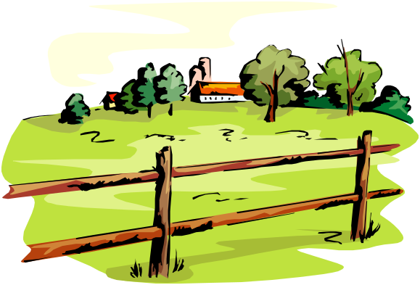
The Comparative
12
The Grass is Always Greener on the
Other Side

Slide 2
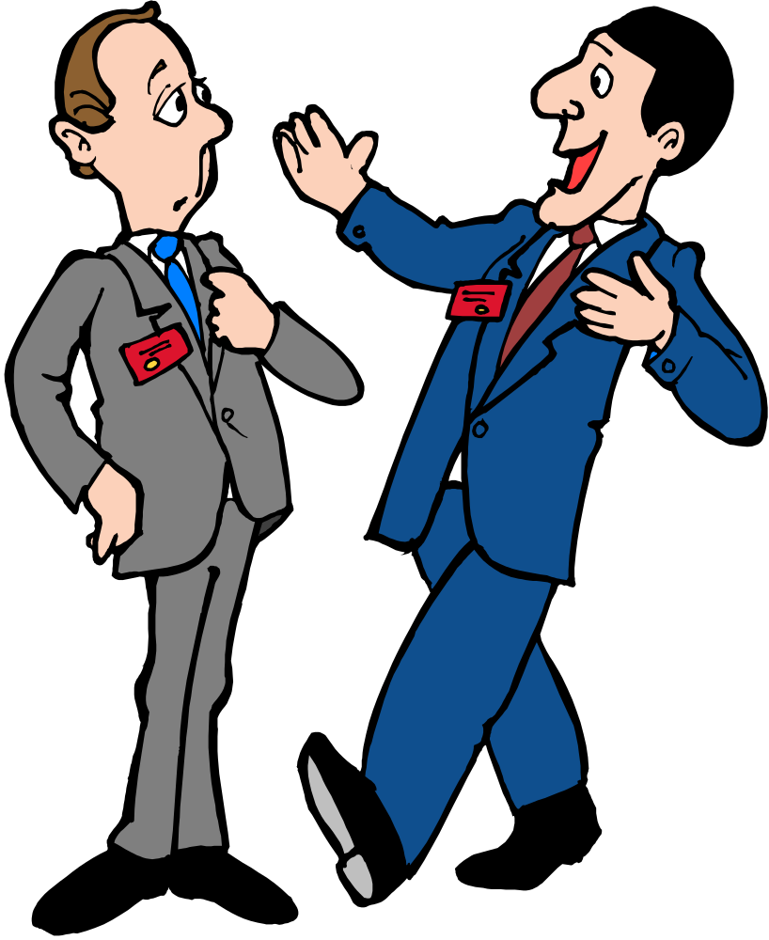
Work Talk 1
Well, my old job was better than this job.
So, how was your first day at your new job?
Oh, really? What was your old job like?

Slide 3

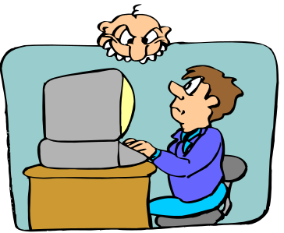
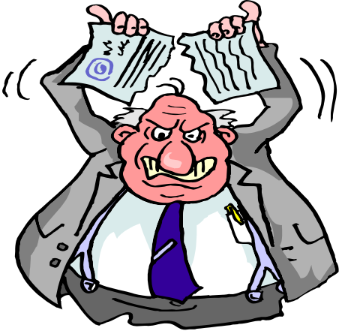
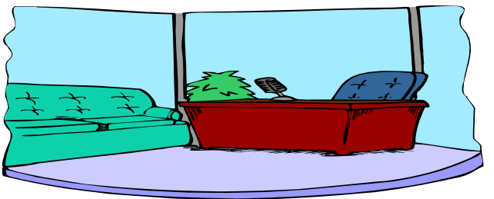
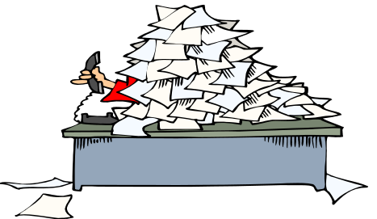
Work Talk 2
My old boss was nicer than my new boss.
My office at my old job was more comfortable.
Oh, I see. Well, I guess the grass is always greener on the other side.
My old job was easier than this job.
the old office
the old boss
the new office
the new boss
the old job
the new job

Slide 4
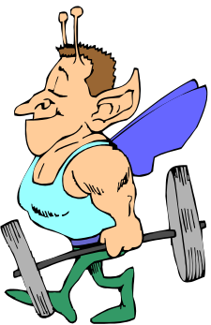
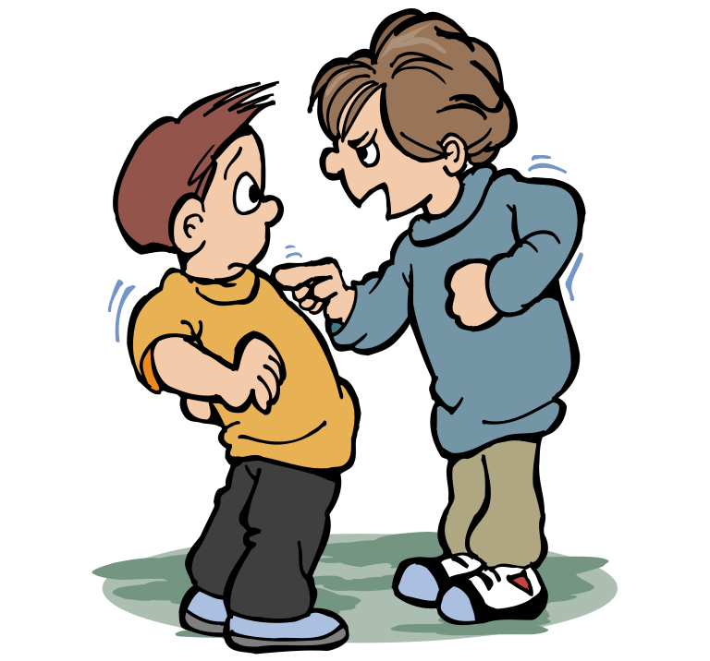
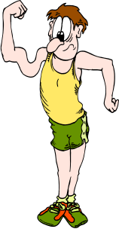
Comparative Adjectives
Use the comparative form of an adjective + than to compare two people, places, or things.
My dad is stronger than your dad.
my dad
his dad

Slide 5
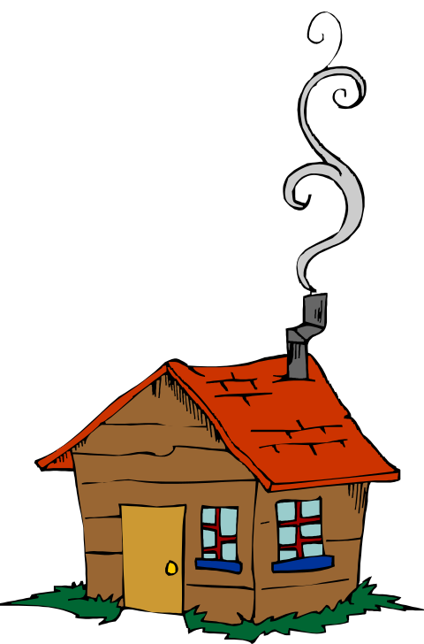
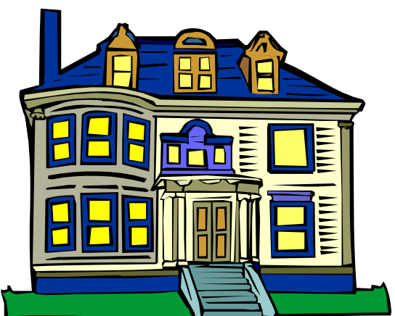
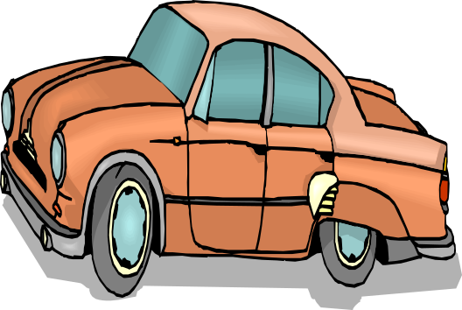
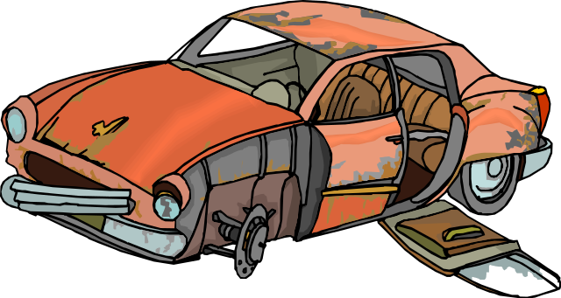
Form 1
To form the comparative of most short (one-syllable) adjectives, add –er to the adjective. Add only –r if the adjective ends in e.
-r
large
-er
old
+
+
=
=
older
larger
Sergiy’s car is
older than
my car.
Olga’s house is larger than
my house.

Slide 6
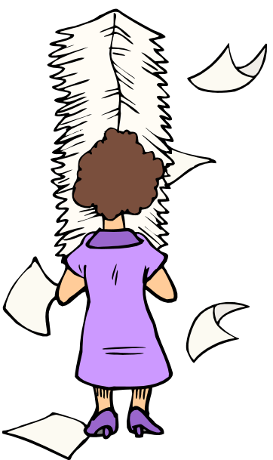
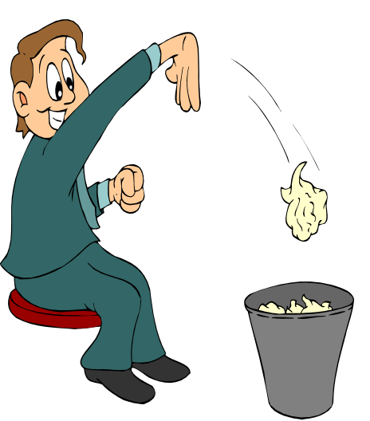
Form 2
To form the comparative of adjectives that end in consonant + y, change the y to i and add –er.
busy
+
-ier
=
busier
Sarah is busier than John.

Slide 7
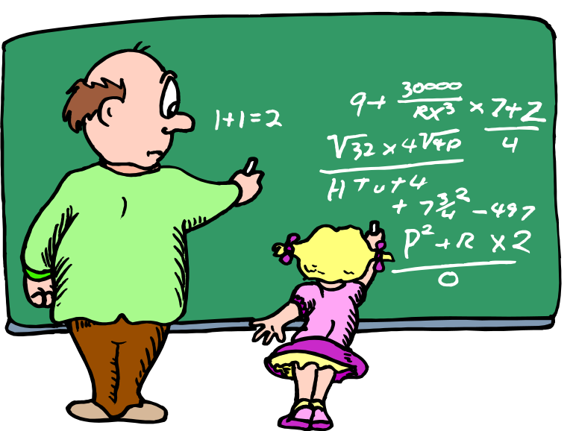
Form 3
To form the comparative of most adjectives of two or more syllables, add more before the adjective.
more
intelligent
more intelligent
+
=
The student is
more intelligent than the teacher.

Slide 8
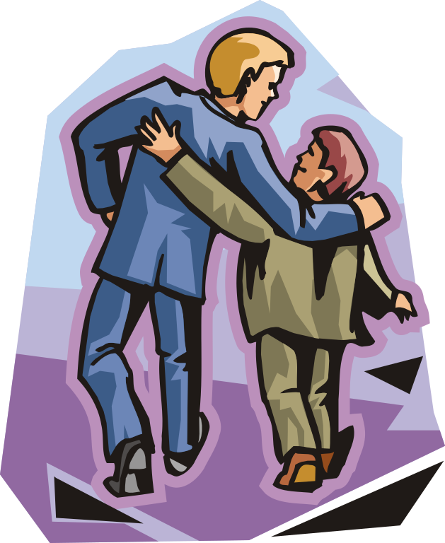
Practice 1
Write the comparative form of the adjectives. Then compare yourself to a friend.
Example: tall
taller than
Steve is
taller than
I am.
I am
taller than George.
friendly
smart
popular
funny
loud
outgoing
friendlier than
smarter than
more popular than
funnier than
louder than
more outgoing than

Slide 9
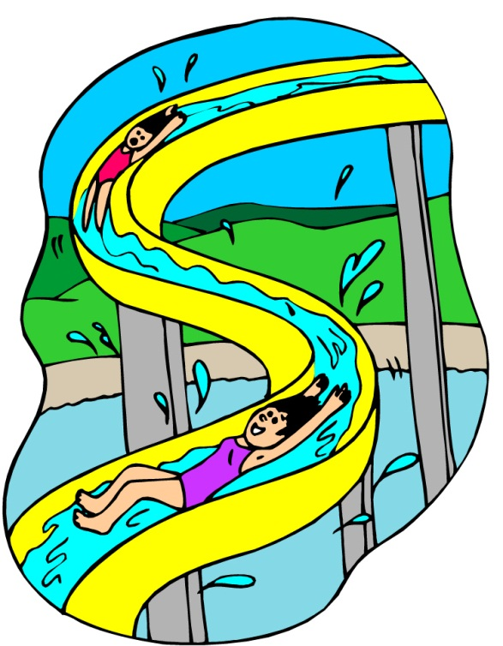
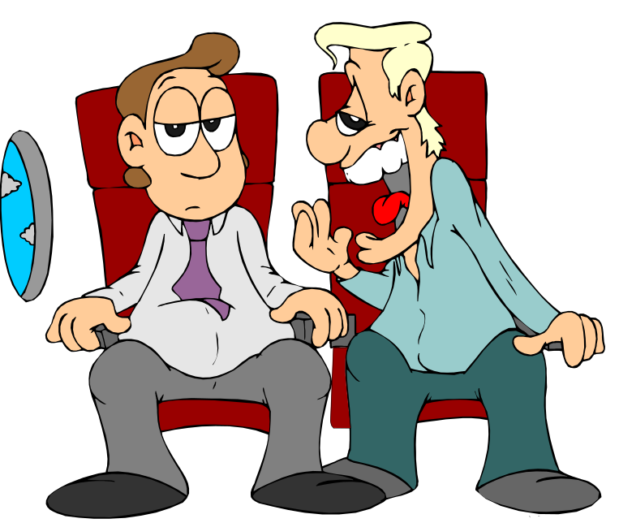
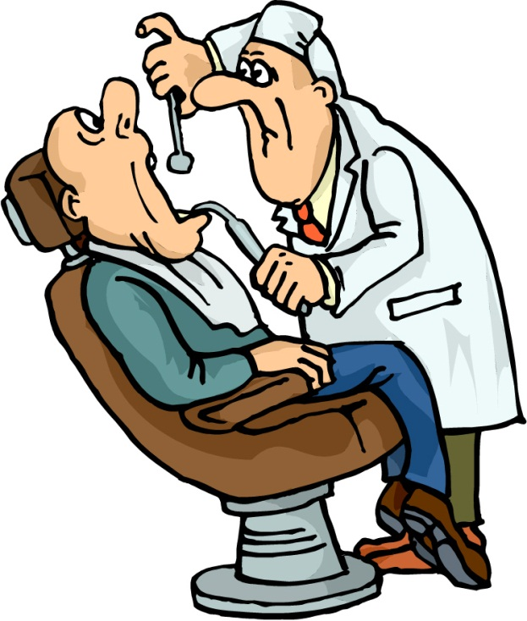
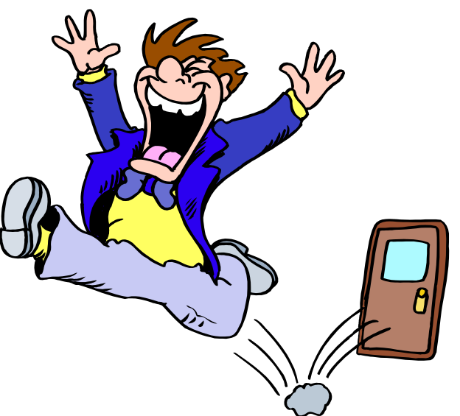
Exceptions 1
Tired, bored, and fun are one-syllable adjectives that follow the pattern of long adjectives.
→ more tired than
  fun
  tired
  bored
→ more bored than
→ more fun than
I am
more bored than
he is.
I am
more tired than
he is.
This is
more fun than that is.

Slide 10
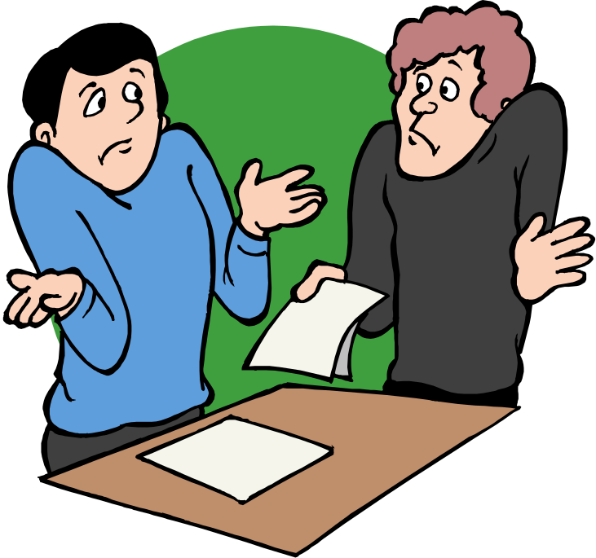
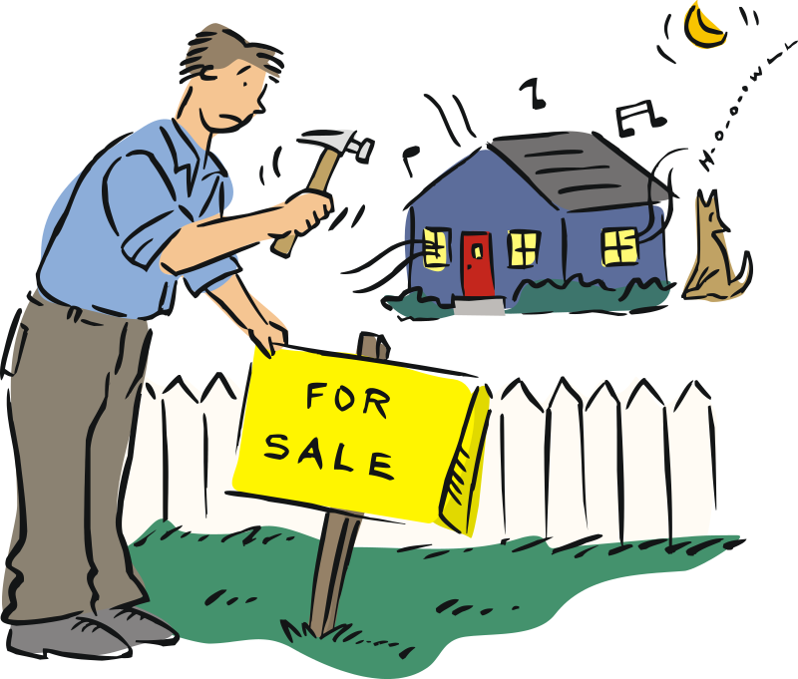
Exceptions 2
Quiet and simple are two-syllable adjectives that follow the pattern of one-syllable adjectives.
  quiet
  simple
→ quieter than
→ simpler than
French was
simpler than
English.
Our old neighbors were
quieter than
these new neighbors.
English
F

Slide 11
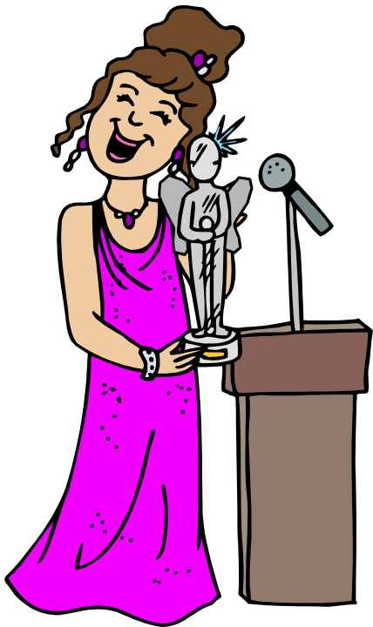
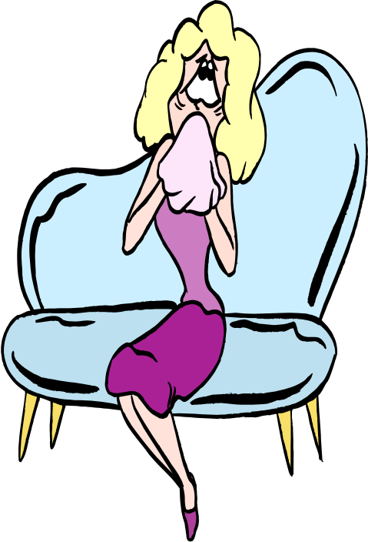
Less and More
Less is the opposite of more.
Sandra is more famous than Liliana.
Liliana is less famous than Sandra.
Liliana
Sandra

Slide 12
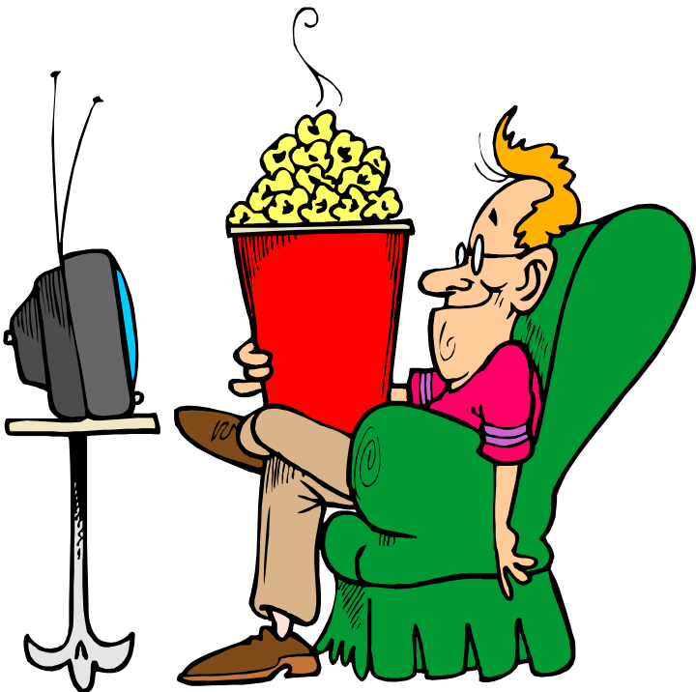
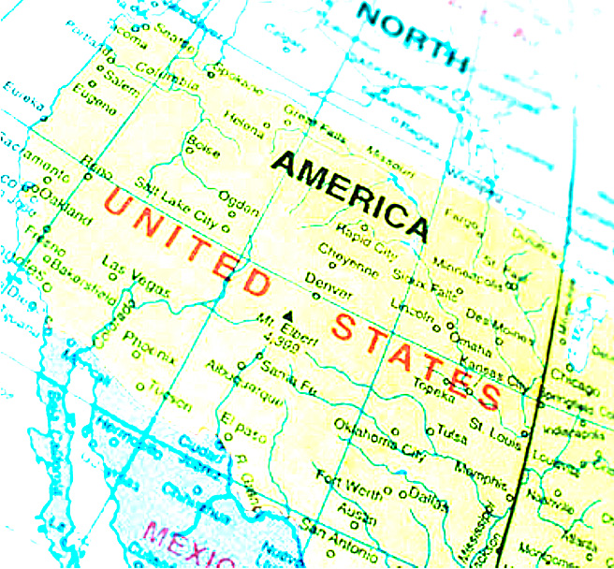
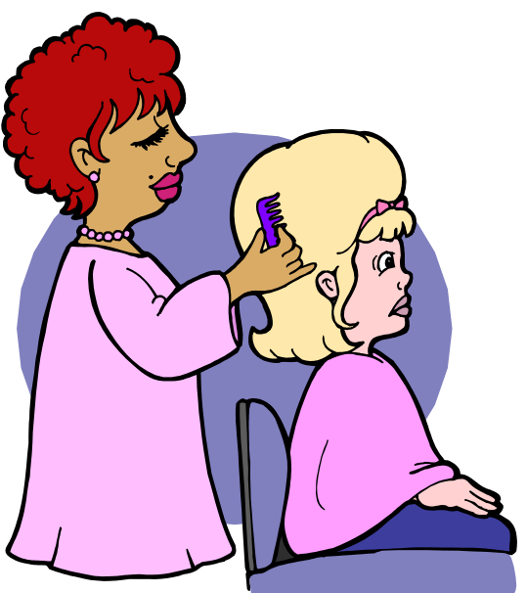
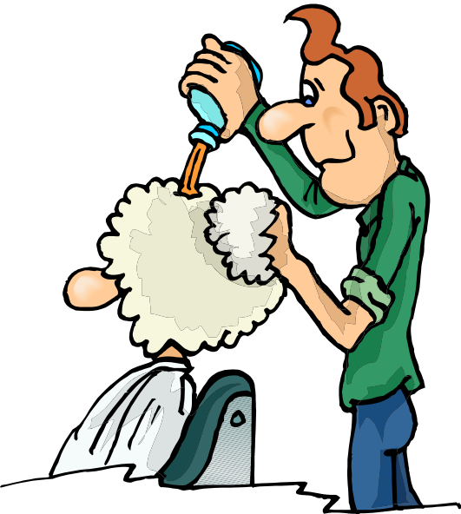
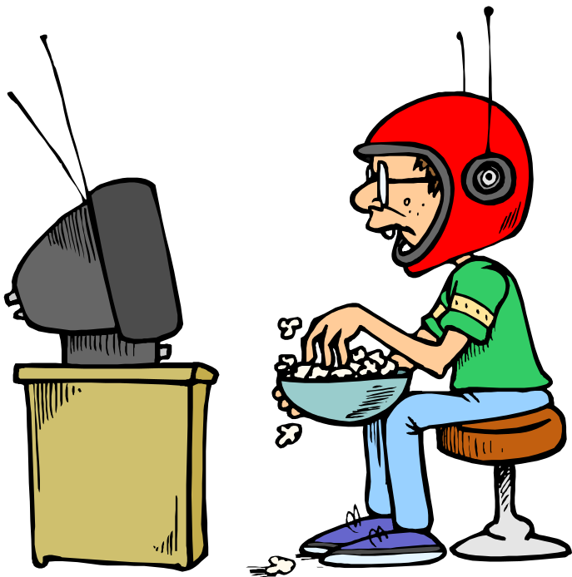
Irregular Forms
The adjectives good, bad, and far have irregular comparative forms.
    good
    bad
    far
→ better
→ farther
→ worse
My popcorn is good, but his popcorn is
better.
My customer’s hairstyle is bad.
My customer’s hairstyle is worse.
Denver, Colorado, is far from San Francisco.
Chicago, Illinois, is even farther from San Francisco.

Slide 13
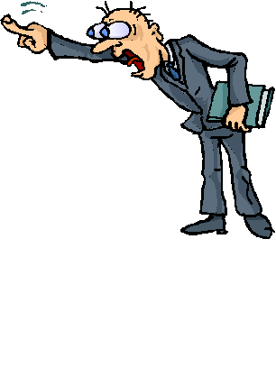
Practice 2
Use the adjectives to compare the two teachers. Try to use much, not as, and less.
strict nice good interesting
old popular angry
Teacher A
Teacher B
Teacher A is not as strict as Teacher B.
Teacher B is stricter than Teacher A.

